Slide 1

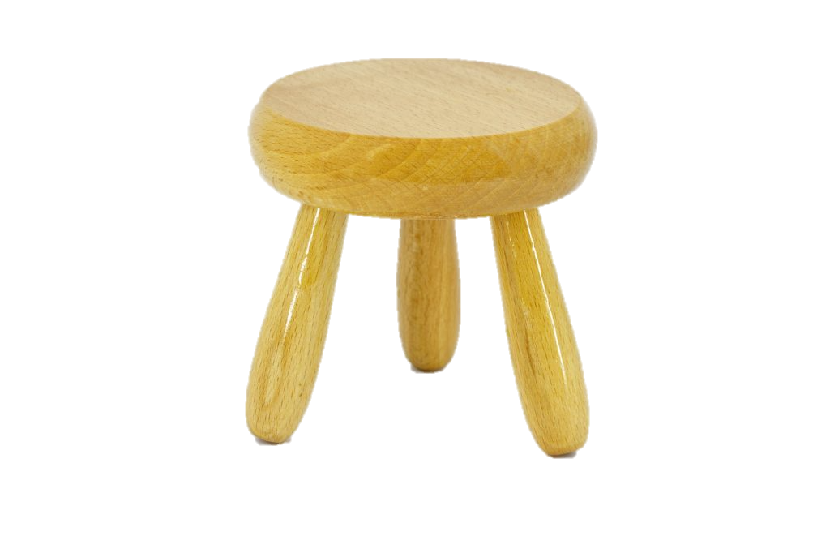
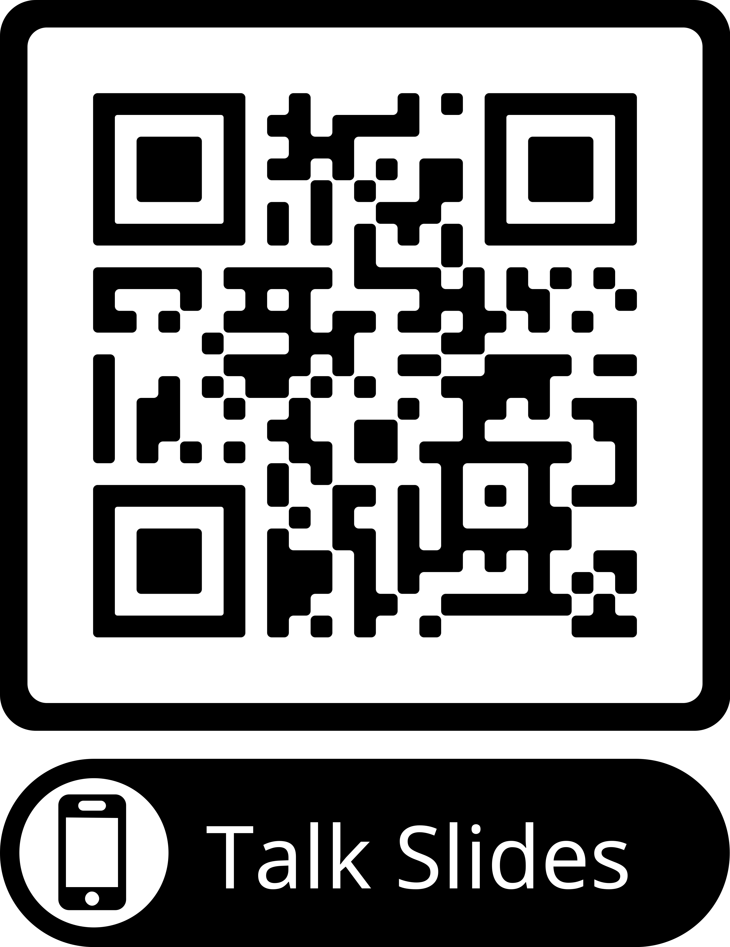
Combining Theory, Experiment, and Computation in Undergraduate Lab Courses
Physics
Theory
Todd Zimmerman
University of Wisconsin - Stout
Experiment
Computation
“a curriculum in which computation is absent or plays a minor role is inauthentic to the contemporary discipline.”¹
[Three-legged stool]. (n.d.). Retrieved July 23, 2018, from https://marketvolt.com/2017/05/marketing-is-a-three-legged-stool/
Notes:
[1] Wolfgang Christian and Bradley Ambrose, “An Introduction to the Theme Double-Issue”, Am. J. Phys. 76 (4&5), 293-294 (2008).
Here in part because of my involvement with PICUP and as a teaser I’ve got an exciting announcement about the future of PICUP at the end of this talk
Abstract: To prepare our students for life after college, we need to provide them with an authentic experience of what research is like. As outlined by the ICEP workshop, this must combine theory, experiment, and computation. I will discuss a freshman-level and and a senior-level lab course that combines theory, experiment, and computation. Many of the activities are drawn from ALPhA and PICUP. I will discuss what these courses look like, what some of the hurdles have been, and what some of the success have looked like.

Slide 2

Curricular Changes: Preparing Our Students
JTUPP Report¹ and EP3 Guide² call for revisiting our curriculum
Advanced Laboratory Physics Association – ALPhA
Partnership for the Integration of Computation into Undergraduate Physics - PICUP
https://www.compadre.org/jtupp/
https://ep3guide.org/
Notes:
Fact that your at AAPT means you are interesting in better preparing our students
Both the JTUPP report and EP3 Guide call for more integration of computational skills and focus on experimental skills
ALPhA has focused on facilitating communication between advanced lab instructors
PICUP is focused on lowering barriers for adding computational modeling into the physics curriculum
Collaborations and overlap between the two but no concerted effort to bridge the two

Slide 3
Integrating Computational and Experimental Physics
ICEP
ICEP workshop convened Summer 2023 by J. F. Reichert Foundation to energize creation of combined computational-experimental activities
12 participants from variety of institutions
Overlap of ALPhA, PICUP, and others involved in lab courses
Follow-up workshop in Summer 2024 with 9 participants
First workshop (2023) inspired changes in two lab courses
Second workshop (2024) spurred changes to several other courses

Slide 4
What does an integrated computational curriculum look like?
Computational Modeling at UW-Stout
Public primarily undergrad
7 faculty but only 4 teach calc-based physics and up
~10 Applied Physics students per year
Integration started ~13 years ago
Computation integrated into all calc-based intro and above
Philosophy is to focus on computational modeling, not programming.
What can the students do with computational skills?
We want them to view computation as just as valid an approach to solving problems as pen-and-paper.

Slide 5
 | In-Class | Homework | Projects | Exams
University Physics I | Yes | - | Yes | -
University Physics II | Yes | - | - | Yes
Modern Physics | - | - | Yes | -
Classical Mechanics | Yes | - | - | -
Applied Optics | Yes | Yes | Yes | -
Solid State | - | - | Yes | -
Quantum Mechanics | Yes | Yes | - | -
Intro to Research | Yes | Yes | Yes | NA
Advanced Lab | Yes | - | Yes | NA
Computer Modeling for Game Designers (not part of major) | Yes | Yes | Yes | Yes
Notes:
Philosophy is to focus on computational modeling, not programming. What can the students _do_ with computational skills? We want them to view computation as just as valid an approach to solving problems as pen-and-paper.
We’ve recently added an intro to quantum computing course which is going on right now
I would consider our program successful if I student would reach for a computer when confronted with a problem and use the tools to develop insight and solutions

Slide 6
 | In-Class | Homework | Projects | Exams
Quantum Revolution for Everyone | Yes | - | Yes | NA
Intro to Quantum Computing | - | Yes | Yes | Yes
Intro to Quantum Information | TBD
Quantum Algorithms | TBD
Notes:
Last two classes are going through approval at the moment, hopefully to be implemented in 2024 or 25
We’ve recently added an intro to quantum computing course which is going on right now
I would consider our program successful if I student would reach for a computer when confronted with a problem and use the tools to develop insight and solutions

Slide 7
University Physics II
Sample curriculum:
Course on trinket.io
VPython in the browser
Live-coding solutions to problems in lecture
Used during lab/discussion
Turn in answers to questions w/ screenshots
Quizzes and exams
Questions on interpreting model results
Used as calculator on quizzes and exam

Slide 8
Upper-Level Courses
Integration more haphazard – instructor dependent
Next steps are to go through EP3 guide with colleagues
Jupyter Notebooks
Lab courses focus on data analysis, creating computer models
Notes:
Two years ago the advanced lab/intro to research course pivoted to online mid semester - looked at chaotic systems

Slide 9
Intro to Research/Advanced Lab
Introduction to Physics Research (PHYS-139) is freshman level research course with no prereq
Advanced Physics Lab (PHYS-439) is upper-level advanced lab course
Both courses share two 3-hour labs each week
Intro students work in group with one advanced student as team leader
Each group works on a single project for entire semester
Focus is on experimental design, data analysis, communication, working in groups/leadership
Computational focus on data collection/analysis
Notes:
Also try to teach them keeping a lab notebook, frustration tolerance, and ethical behavior
Shoe-string budget so most experiments are home-built by students

Slide 10
ICEP in Lab
Goal: Each experiment will have meaningful computer modeling in addition to data analysis
Experiments integrated:
Saturated absorption spectroscopy
E.g. https://pubs.aip.org/aapt/ajp/article/80/8/740/1057552/An-undergraduate-measurement-of-radiative?searchresult=1
Mechanical Chaotic Oscillator
https://advlabs.aapt.org/wiki/UWRF_Mechanical_Chaotic_Oscillator
Surface Plasmon Resonance
E.g. https://advlabs.aapt.org/wiki/Plasmonics_and_Surface_Enhanced_Spectroscopy
Digital Image Correlation of Fluid Flow
https://advlabs.aapt.org/bfyiii/detail.cfm?ID=7454
Notes:
Focus on most successful integrations
SPR isn’t giving correct results at this time
Neither is fluid flow

Slide 11
Saturated absorption spectroscopy of Rb
Experimental goal: Get home-built SA setup working to SA peaks
Computational goal: Recreate absorption peaks and see contribution of different features
Notes:
Find reference to where I got the images. Maybe Thorlabs?

Slide 12
Computer Modeling of Saturated Absorption Signal
Model atoms as they interact with light
Digital experiments:
Doppler shifted frequencies for individual atoms
Random sampling of velocities to product doppler-broadened curve
Add in counter-propagating lasers
Add in three excited levels

Slide 13
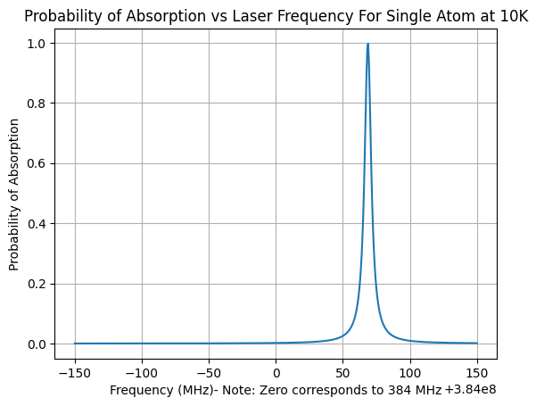
Computer Modeling of Saturated Absorption Signal
Model atoms as they interact with light
Digital experiments:
Doppler shifted frequencies for individual atoms

Slide 14
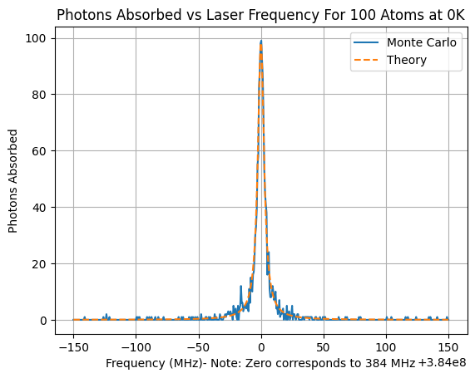
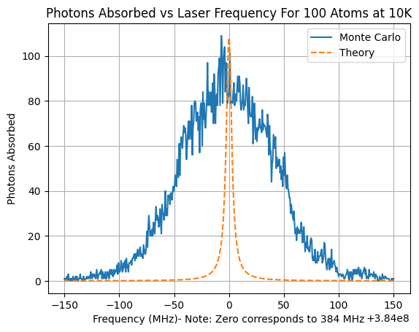
Model atoms as they interact with light
Digital experiments:
Doppler shifted frequencies for individual atoms
Random sampling of velocities to product doppler-broadened curve

Slide 15
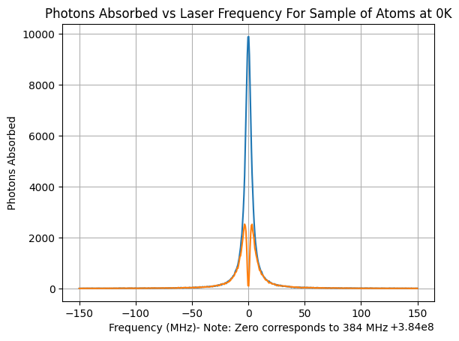
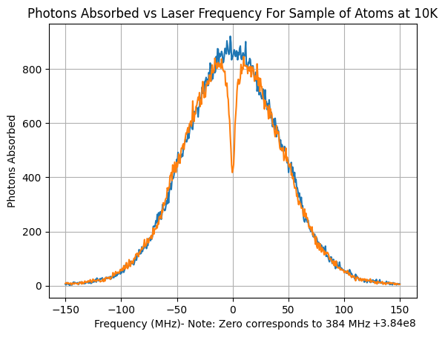
Model atoms as they interact with light
Digital experiments:
Doppler shifted frequencies for individual atoms
Random sampling of velocities to product doppler-broadened curve
Add in counter-propagating lasers

Slide 16
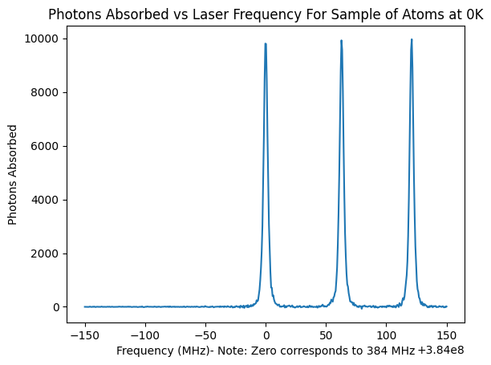
Model atoms as they interact with light
Digital experiments:
Doppler shifted frequencies for individual atoms
Random sampling of velocities to product doppler-broadened curve
Add in counter-propagating lasers
Add in three excited levels
Notes:
Find reference to image

Slide 17
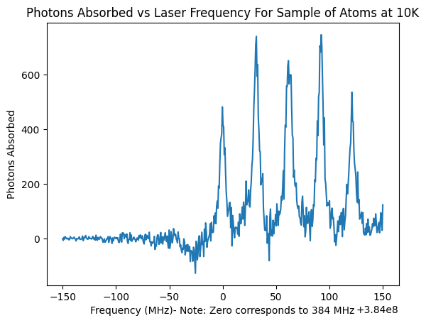
Model atoms as they interact with light
Digital experiments:
Doppler shifted frequencies for individual atoms
Random sampling of velocities to product doppler-broadened curve
Add in counter-propagating lasers
Add in three excited levels

Slide 18
Model atoms as they interact with light
Digital experiments:
Doppler shifted frequencies for individual atoms
Random sampling of velocities to product doppler-broadened curve
Add in counter-propagating lasers
Add in three excited levels
Can extend to include other effects
E.g. Intensity-dependent and radiation broadening

Slide 19
Mechanical Chaotic Oscillator
Part of PICUP/ALPhA immersion – Eric Ayars
See https://advlabs.aapt.org/wiki/UWRF_Mechanical_Chaotic_Oscillator
Experimental goal: Gather phase space plots for various driving/damping conditions
Computational goal: Model broad behavior to match experimental conditions

Slide 20
Hurdles you might encounter
Resistance to Any Changes
Student Resistance
Expectations of Content Coverage
Time Structure
Departmental Norms
Lack of Instructor Time
Computation-Specific
Lack of instructor knowledge
Accessible platform
The IT Crowd
Leary, Ashleigh, Paul W. Irving, and Marcos D. Caballero. "The difficulties associated with integrating computation into undergraduate physics." arXiv preprint arXiv:1807.03581 (2018).
Notes:
Systemic forces that make implementing changes in your classroom challenging
Left-hand column based on work by Melissa Dancy and Charles Henderson on why more faculty don’t implement PER-based strategies in their classes.
Dancy and Henderson: https://journals.aps.org/prper/abstract/10.1103/PhysRevSTPER.3.020102

Slide 21
Hurdles I encountered
Resistance to Any Changes
Student Resistance
Expectations of Content Coverage
Time Structure
Departmental Norms
Lack of Instructor Time
Computation-Specific
Lack of instructor knowledge
Accessible platform
The IT Crowd
Leary, Ashleigh, Paul W. Irving, and Marcos D. Caballero. "The difficulties associated with integrating computation into undergraduate physics." arXiv preprint arXiv:1807.03581 (2018).
Notes:
Systemic forces that make implementing changes in your classroom challenging
Left-hand column based on work by Melissa Dancy and Charles Henderson on why more faculty don’t implement PER-based strategies in their classes.
Dancy and Henderson: https://journals.aps.org/prper/abstract/10.1103/PhysRevSTPER.3.020102

Slide 22
“Ease” of Change
Young program
Expectation of topics not set
Almost all students go into industry
Limited need for grad school prep
Small number of faculty
Easier consensus

Slide 23
Future integrations
Single Photon Interference
https://people.reed.edu/~beckm/QM/
Brownian Motion and Smoke Chains
https://pubs.aip.org/aapt/ajp/article/91/4/316/2878662/An-economical-smoke-chamber-and-light-sheet?searchresult=1
Acoustic Trapping
https://pubs.aip.org/aapt/ajp/article/92/1/59/2930521/Acoustic-trapping-in-the-undergraduate-laboratory?searchresult=1
Light Scattering Phenomena
https://pubs.aip.org/aapt/ajp/article/69/2/129/1030277/Particle-size-determination-An-undergraduate-lab?searchresult=1

Slide 24

Integrating Theoretical, Computational, and Experimental Physics
T
Physics
I CEP
^
Theory
Experiment
Computation
[Three-legged stool]. (n.d.). Retrieved July 23, 2018, from https://marketvolt.com/2017/05/marketing-is-a-three-legged-stool/

Slide 25
My ITCEP Agenda
Physics
Integrate theory, computation, experiment into traditional theory-based courses and lab-based courses
Theory
Experiment
Computation
[Three-legged stool]. (n.d.). Retrieved July 23, 2018, from https://marketvolt.com/2017/05/marketing-is-a-three-legged-stool/

Slide 26
Creating Resources
Physics
What does ITCEP look like?
Not everyone has skills in all three areas across all fields of physics
Provide resources to integrate all three aspects into all courses across the curriculum
Resources must be modular
Resources must be scalable
Experiments should be low-cost or use common equipment as much as possible
Theory
Experiment
Computation
[Three-legged stool]. (n.d.). Retrieved July 23, 2018, from https://marketvolt.com/2017/05/marketing-is-a-three-legged-stool/

Slide 27
Classical Mechanics (Fall 2024)
Shift from three 1-hour lectures to two 1-hour lectures and one 2-hour lab per week
Experiments: Physics of toys
Parachute
Swings
Slinkys
Gravity well
Rattleback
Tipee Top and other tops

Slide 28
Quantum Mechanics (Spring 2025)
Shift from three 1-hour lectures to two 1-hour lectures and one 2-hour lab per week
Experiments:
Polarized light
Mach-Zehnder interferometer
NMR (Teachspin Quantum Control)
Single-photon interference

Slide 29

A Call to the Community!
Submit activities or other material to PICUP Faculty commons
Students should have to rely on theory, computational modeling, and experimentation
PICUP Faculty Commons submission: https://www.compadre.org/PICUP/exercises/Guidelines-Technical.cfm?FA=2
Horn Image: Vincent Le Moign, CC BY 4.0 <https://creativecommons.org/licenses/by/4.0>, via Wikimedia Commons

Slide 30
PICUP SLICE and DICE
Summer Leadership Institute for Computational Education in Physics (SLICE)
whose central goal will be to grow and sustain a network of educational leaders in computational physics education who will support the continual evolution of computational teaching and learning needs in physics, and the
Distributed Institutes for Computational Education in Physics (DICE)
Regional workshops on integrating computation
Watch PICUP Events page for upcoming events
https://www.compadre.org/PICUP/events/

Slide 31
Thank You!
Thank you to the following
Jonathan F. Reichert Foundation
UW-Stout CSTEMM Dean Dan Freedman
UW-Stout Chancellors Professional Development Fund
Dept. of Chemistry and Physics

Slide 32
Resources
PICUP Website:
gopicup.org/
Video overview of website here
Exercise sets
Faculty commons
Resources
Webinars
Slack
Effective Practices for Physics Programs (EP3):
Best practices for implementing change within your department
Section on computational skills
ep3guide.org/
Paper on hurdles implementing computation
Leary, Ashleigh, Paul W. Irving, and Marcos D. Caballero. "The difficulties associated with integrating computation into undergraduate physics." arXiv preprint arXiv:1807.03581 (2018).
J-TUPP Recommendations:
Sample learning goals on page 19

